Slide 1

The Maximum k-Colorable Subgraph Problem
James Kyle Harrison

Slide 2
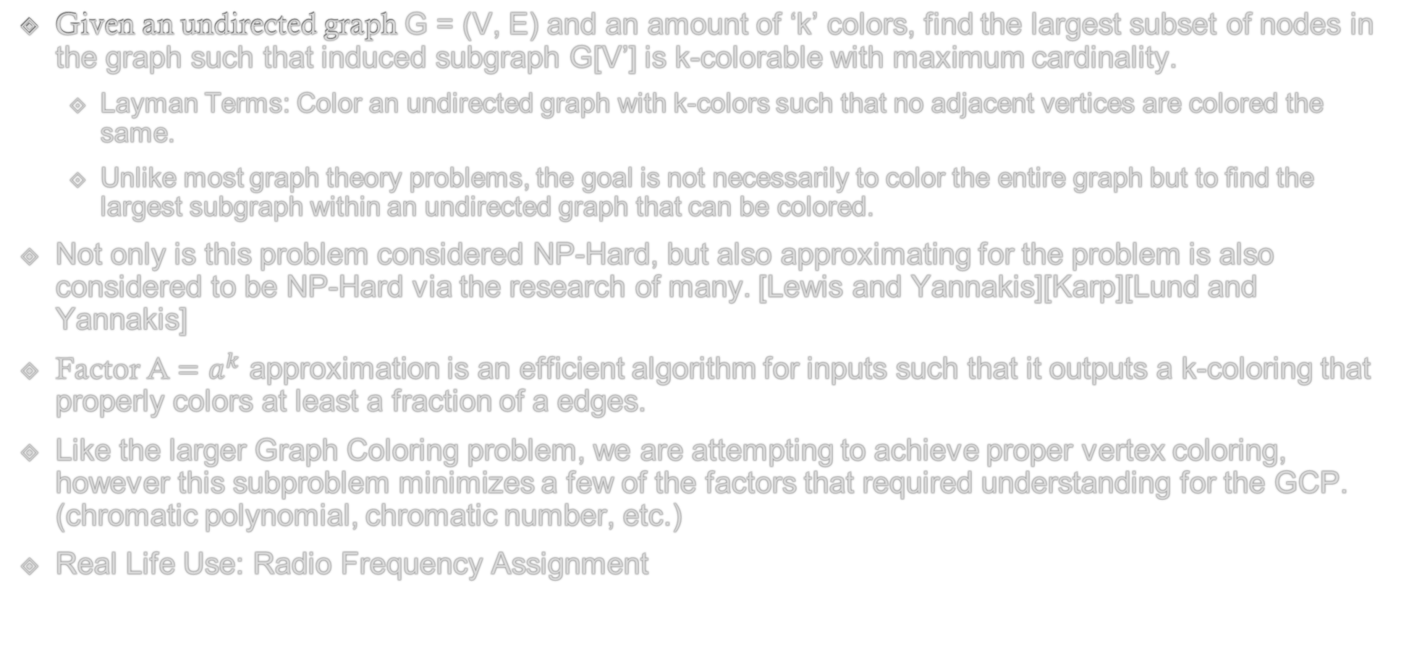
The Maximum k-Colorable Subgraph Problem
Given an undirected graph G = (V, E) and an amount of ‘k’ colors, find the largest subset of nodes in the graph such that induced subgraph G[V’] is k-colorable with maximum cardinality.
Layman Terms: Color an undirected graph with k-colors such that no adjacent vertices are colored the same.
Unlike most graph theory problems, the goal is not necessarily to color the entire graph but to find the largest subgraph within an undirected graph that can be colored.
Not only is this problem considered NP-Hard, but also approximating for the problem is also considered to be NP-Hard via the research of many. [Lewis and Yannakis][Karp][Lund and Yannakis]
Factor A $=a^{k}$ approximation is an efficient algorithm for inputs such that it outputs a k-coloring that properly colors at least a fraction of a edges.
Like the larger Graph Coloring problem, we are attempting to achieve proper vertex coloring, however this subproblem minimizes a few of the factors that required understanding for the GCP. (chromatic polynomial, chromatic number, etc.)
Real Life Use: Radio Frequency Assignment
Notes:
- Unique Games Conjecture: Postulates that the problem of determining the approximate value of a certain type of game has NP-hard Complexity as P != NP.

Slide 3
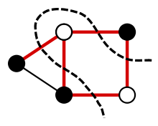
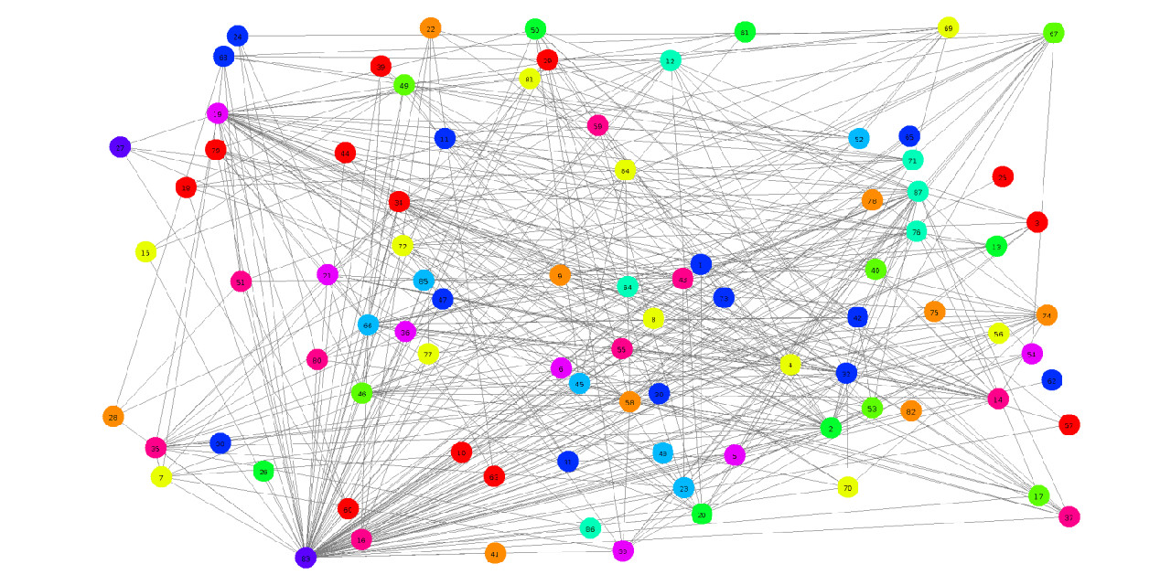
Related Problems and Concerns
Though research typically tends to favor general Graph Coloring Problems (or other problems in Graph Theory) there is plenty of crossover with this problem and other problems.
Maximum Bipartite Subgraph is the same problem with k=2
The Max k-Cut/Max Cut Problems
K-Stage Covering Problem
Maximum Clique Problem
Vertex Covering Problem
All these problems require optimization techniques to find local optimal solutions and are combinatorial in nature such that heuristic methods are often used to find appropriate solutions.
Though there are enough similarities to investigate for guidance on creating an evolutionary approach to our problem, the branching data sets and differences in necessities can obscure the ability to directly compare with other evolutionary implementations.
Notes:
- Max k-Cut problem the input is an arbitrary graph

Slide 4
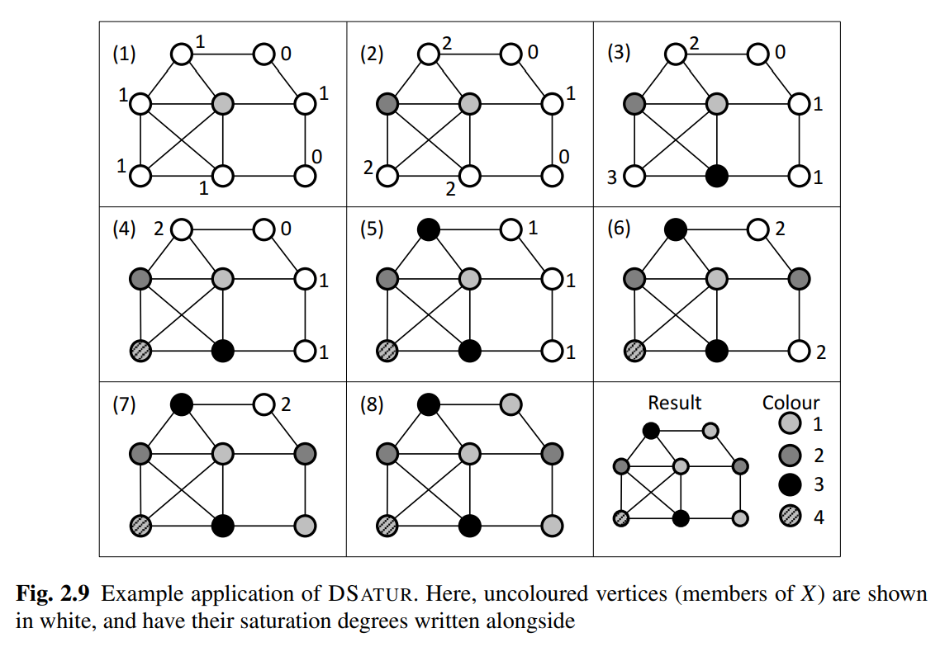
Pre-Evolutionary Model - DSatur
DSatur (Degree of Saturation): An approach created by Daniel Brelaz in 1979 that can be described as somewhere between a greedy implementation and an evolutionary implementation for graph coloring.
Selects a vertex and colors it. The algorithm will then select the vertices with the highest (degree of saturation) number of colors in its neighborhood and colors said vertex.
This heuristic algorithm was heavily influential in creating global optimal solutions in the Maximum Bipartite Subgraph Problem.
Was run with the expectation that the algorithm would be used
multiple times such that the chromatic polynomial of a graph
could be analyzed.

Slide 5

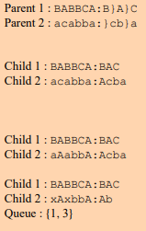
Modern Genetic Algorithms - Grouping
Grouping Genetic Algorithm (GGA): Specialized in taking on problems
that requires a particular structure or grouping to create a local optimum solution.
The implementation studied was Eiben, Hauw, and Hemert’s implementation (based off Emaneul Falkenaeur’s work) of a grouping genetic algorithm.
Key Concept: Takes the individuals of a chromosome and creates a grouping of k elements for Crossover.
Crossover:
Copy Parent 1 to Child 1 and copy Parent 2 to Child 2. Select at random two crossing sites, delimiting the crossing section in each of the two parents’ group part.
Inject the contents of crossing section of the first parent before the first crossing site of the second child.
Overwrite the object section of child 2 such that membership of the newly inserted groups are enforced.
Adapt to the problem and remove groups that become empty while storing unassigned objects.
Repeat with the other parent.

Slide 6
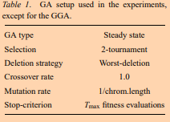

Eiben, Hauw, and Hemert’s Grouping Genetic Algorithm -Continued
Population: Steady-State. Keeps the population size rather small and continuously improves upon the population through iterations, only removing the worst.
As Grouping requires the creation of additional lists and comparisons it can help offset the additional memory allocation.
Initialization: coloring every individual in the population using first-fit heuristic starting at a random node.
Mutation: A number of elements in the group are deleted with the objects uncolored. These uncolored nodes will then go through the same heuristic from crossover.
Inversion: Randomly marks two points in the groups and flips the order.
Fitness: Defined by the number of nodes that do not have as many nodes as the colors with the third most nodes (EX: if color A, B, and C had 6 nodes colored and nodes D and E had 5, the fitness would be 2)
Notes:
K = Number of Colors Used, L = Number of Colors, graph(x, ci) occurs such that each incremented child has a fitness less than or equal to the proceeding child.

Slide 7
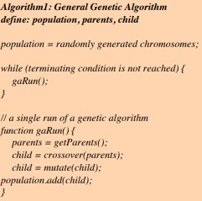
Hindi and Yampolski’s “Generic” Genetic Algorithm
In a comparison of dozens of implementations of genetic algorithms, a general pattern can be determined on what is considered the baseline attempt at creating a genetic algorithm for graph coloring problems in general:
Population: Standardized to 50
Generations: Standardized to 100 or 20000 depending on complexity
Crossover: 1-Point Crossover of random assignment
Mutation: Random change
This baseline gives a great start to how one can create their own implementation, although testing against it will show just how inefficient it can still be.

Slide 8
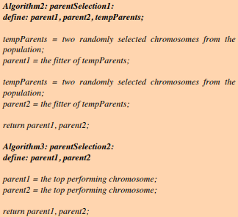
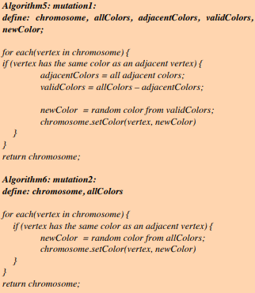
Improving on the Generic Algorithm
Hindi and Yampolski suggest that creating a general solution implementation requires forethought into the form of optimization problems that can occur within generating population, so although the population size is already kept low it is best to more than one form of selection that can be used in conjunction depending on the situation.
The implementation they went forward with also used two mutation functions in conjunction with the logic of the selection functions so that more memory and time efficient functions can be run when dealing with better fitness’s.
Generic Crossover
Wisdom of Artificial Crowds: If algorithm cannot find an optimal solution, return best-fit solution.
Notes:
If the fitness is greater than 4 Selection and Mutation 1 are used, else Selection and Mutation 2 are used.

Slide 9
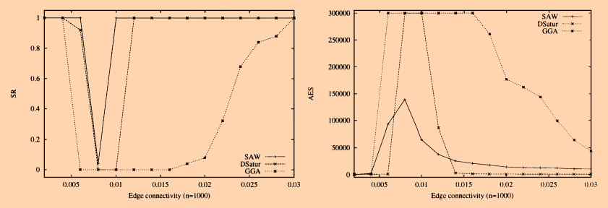
Comparison
Operators remain largely the same with functional differences.
Crossover and Mutation is largely the focus of the operational differences, where implementations strive to typically keep a lower population and focus on the strengths of the designs selected to achieve local optimum solutions
Dsatur is able to defeat the Grouping Genetic Algorithm in how long it takes to reach an optimal solution, however the GGA is able to eventually create a solution using less memory/lower complexity.
As a result, it is implied that the GGA should not compare as well to Hindi and Yampolskiy’s approach.

Slide 10
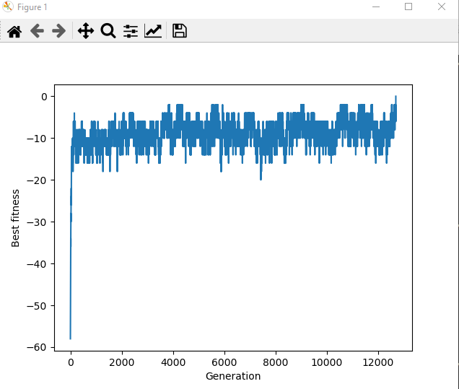
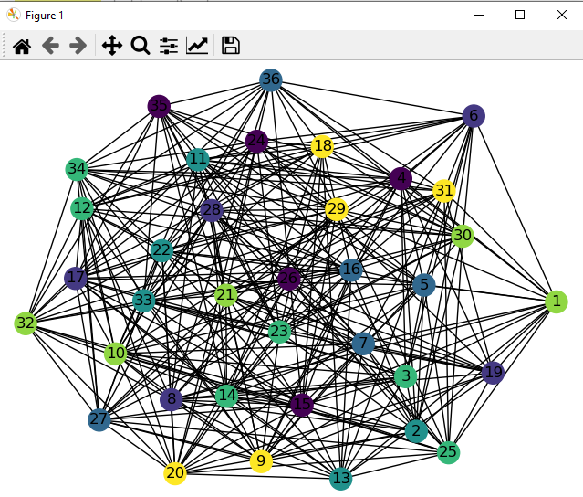
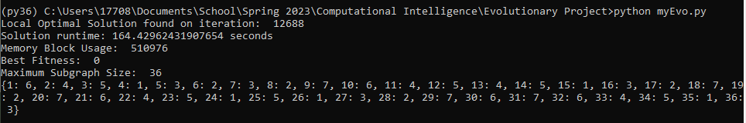
Takeaways for my approach
The focus overall goal is to find a solution (with 0 conflicts) or run until we hit a predefined number of generations – Generic by tried and true
Steady State Algorithm
Premature Convergence is an issue of high importance, and thus achieving diversity in our population while improving is of high importance.
Benchmarks of Importance: Runtime, Memory Usage, Best fitness of generation, graph coloring
Notes:
1. Though this is simple, as are goal is to produce the largest Maximum Subgraph it will help us in our fitness function.

Slide 11
References
1 Bŕelaz, Daniel (1979-04-01). ”New methods to color the vertices of agraph”. Communications of the ACM. 22 (4): 251–256. doi:10.1145/359094.359101.ISSN 0001-0782. S2CID 14838769.
2 Eiben, Hauw, and Hemert. (1998) ”Graph Coloring with Adaptive Evolutionary Algorithms”, Leiden University - Journal of Heuristicshttps://www.cs.vu.nl/ gusz/papers/Graph%20Coloring%20with%20Adaptive%20Evolutionary%20Algorithms.pdf
3 Hindi and Yampolskiy (2012). ”Genetic Algorithm Applied to the Graph Coloring Problem” J.B. School of Engineering https://ceur-ws.org/Vol-841/submission 10.pdf
4 Hochbaum, Dorit S, and Anu Pathria. “Analysis of the Greedy Approach in Problems of Maximum k-Coverage.” University of California, Berkeley Research, 9 Mar. 1998, https://hochbaum.ieor.berkeley.edu/html/pub/HPathria-max-k-coverage-greedy.pdf.
5 Januschowski, Tim, and Marc E Pfetsch. “The Maximum k-Colorable Subgraph Problem and Orbitopes.” Science Direct - Elsevier, 26 May 2011, https://www.sciencedirect.com/science/article/pii/S1572528611000272.
6 Lovasz, L., An Algorithmic Theory of Numbers, Graphs, and Convexity, CBMS 50, SIAM, Philadelphia, 1986. https://doc.lagout.org/science/0 Computer%20Science/2Algorithms/An%20Algorithmic%20Theory%20of%20Numbers,%20Graphs%20and%20Convexity%20%5BLov%C3%A1sz%201987-01-01%5D.pdf
7 Miller and Goldberg (2005) ”Genetic Algorithms, Tournament Selection, and the Effects of Noise” Complex Systems 9, 193-212, https://wpmedia.wolfram.com/uploads/sites/13/2018/02/09-3-2.pdf
8 Narasimhan, Giri. “The Maximum K-Colorable Subgraph Problem.” University of Wisconsin Research, https://research.cs.wisc.edu/techreports/viewreport.php?report=864.
9 Olga et al, ”The Maximum k-colorable subgraph problem and related problems”, Arxiv, https://arxiv.org/pdf/2001.09644.pdf7

